Slide 1

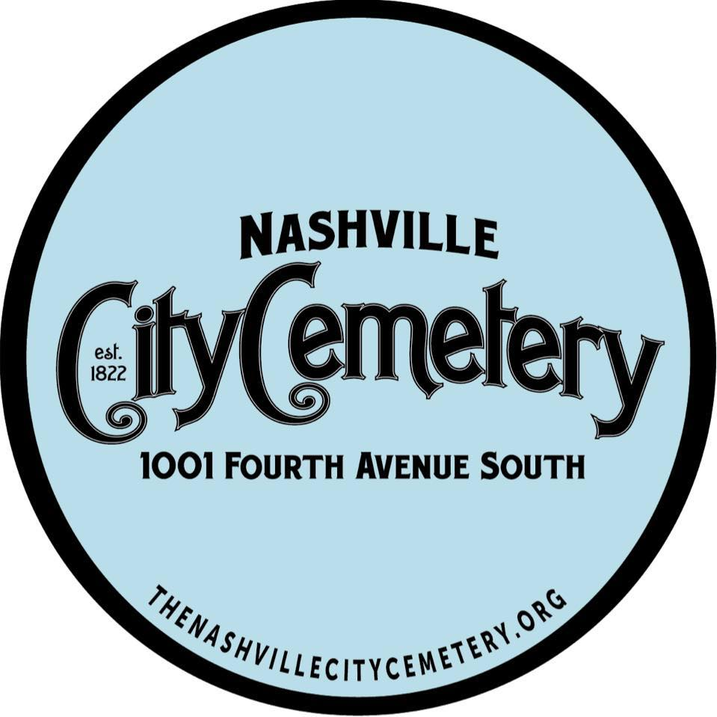
A Walk through the past
Our mission: To protect, preserve, restore, and educate the public about the cemetery, Nashville's "Premier Outdoor History Museum."

Slide 2
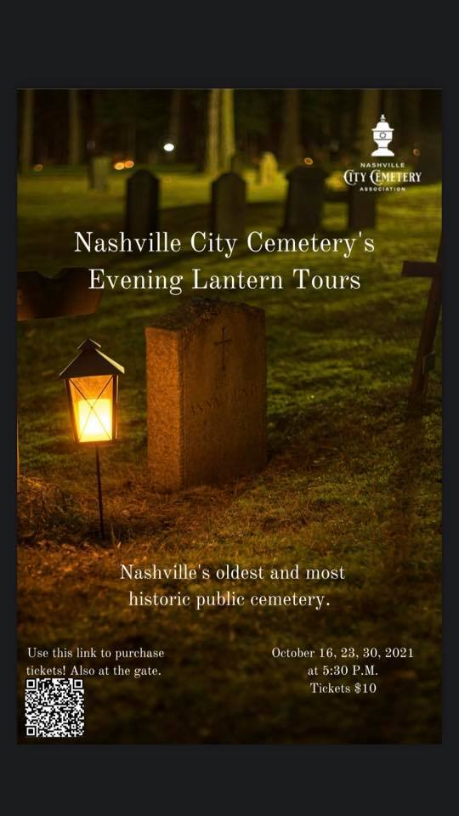
How Can We Engage?
Let’s Increase Our Presence
Nashville City Cemetery (@nashvillecitycemetery) • Instagram photos and videos
(1) Nashville City Cemetery Association | Facebook

Slide 3
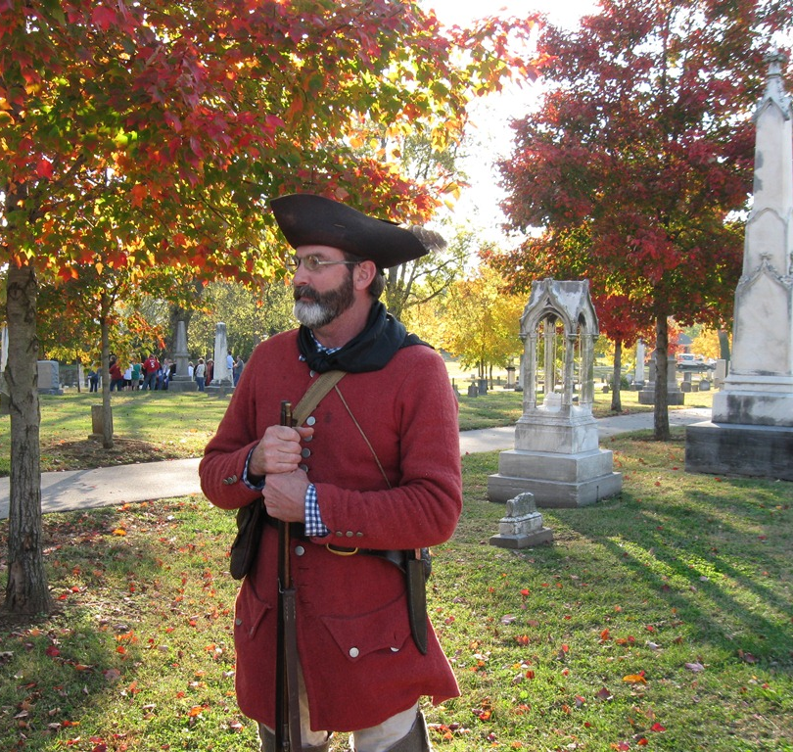
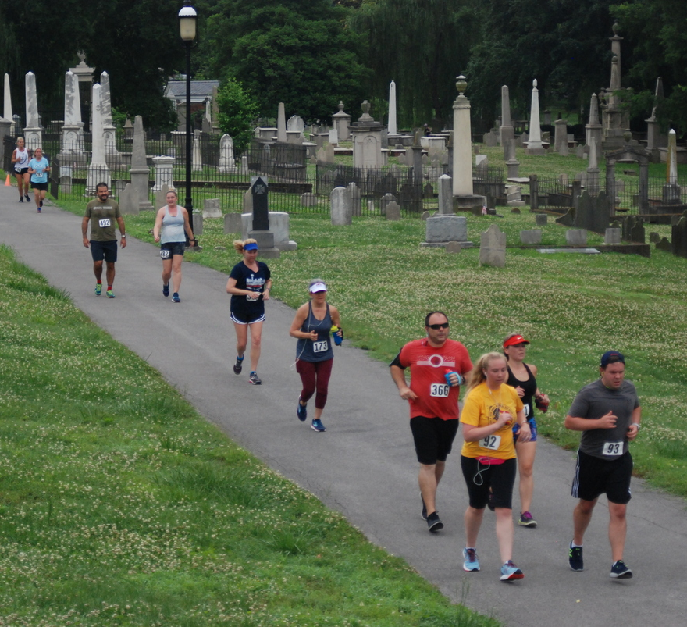
Can Fun Be Had?
Civil War Tours
Living History Tours
Evening Lantern Tours
Memorial Day Dash 5k
Scavenger Hunts
Annual Weed Wrangle

Slide 4
Learning About Historical Moments
What Happened Between 1861-1865?

Slide 5

Why Are They Here?
Fundraising Event Ideas:
June is World Awareness Infertility Month
October 15- Pregnancy and Infant Loss Remembrance Day

Slide 6
Can You Die of a Broken Heart?
People who died from “Affections of the Heart”
Can you find:
Thos. Howlett
Prudence Allcorn
Mary Buck Wm Jenkins
Malinda
Mary Putnam

